Slide 1
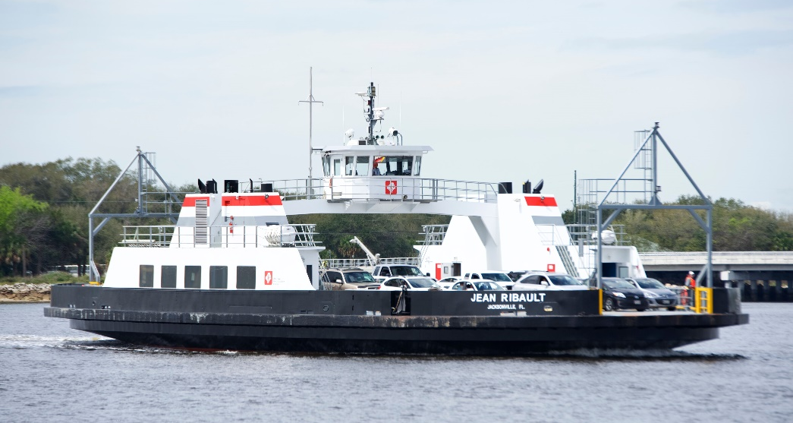
Disadvantaged Business Enterprise Program
presented by Ken Middleton
Director – Diversity, Equity & Customer Advocacy

Slide 2
DBE Program At-a-Glance

Slide 3
U.S. DOT Federal Funding Flow

Slide 4
Why the Change?
2013 – Results of Disparity Study published
How can we make the DBE program meet the needs of the small business community?
They spoke and we listened?

Slide 5
Joint Agency Task Force formed in December 2013 (monthly meetings)
Hired additional DBE staff to support increased program demands
Interlocal agreement with JAA for partial funding of DBE Compliance Specialist
Mandatory DBE training for all new employees within first 30 days
Applied for and was awarded $200K FTA grant to support DBE Program
Created Business Development Academy Seminars held each quarter
Created Workforce Development Initiative (Back-2-Work Program)
Purchased B2GNow online application module for certifications and re-certifications
All pre-bid meetings are now no longer mandatory
Improvements made to JTA’s DBE website
Weekly email notifications to small business community of JTA contract opportunities
Process Improvements

Slide 6
“Doing Business with JTA” workshops held every other month at JTA
Quarterly newsletter published with “partnering agencies”
Joint workshops held with “partnering agencies”
Re-established Access-2-Capital Program for small business in partnership with COJ
Bi-weekly meetings held with Finance to ensure DBE progress payments are on time for processing
Monthly check on all active DBE contracts/subcontracts for adherence to “Prompt Payment” clause
May 2015 - Implemented Prime “self-reporting” system in B2GNow that allows timely tracking of prime payments
Removed FDOT prequalification requirements for subcontractors for road construction projects
Risk Management - Less restrictive insurance requirement for small businesses
Allow prime contractors to turn in DBE documentation 48 hours after bid closing
Process Improvements

Slide 7
DBE Staff & Office Functions
Disadvantaged Business Enterprise (DBE)
Ken Middleton
Director – Diversity, Equity & Customer Advocacy
Workforce Development Programs
Yetunde Oyewole
Sr. Diversity
Compliance Specialist
Chris Macklin
Diversity Compliance Specialist II
Americans with Disability Act (ADA)
Title VI
Equal Employment Opportunity (EEO)
Civil Rights Programs
Terri James
Diversity Compliance Specialist I
Add copy here

Slide 8
DBE Program Mission
Ensures a “level playing field”
Fosters equal opportunity
Improves contracting flexibility and efficiency
Reduces burdens on small businesses
Ensures the program is narrowly tailored
Assists in the development of firms

Slide 9
DBE Certification Requirements
For-profit entity
Small business as defined by the U.S. SBA
Owner(s) must be socially and economically disadvantaged
Owner(s) must have at least 51% ownership interest in business
Must manage and control daily operations
Must have industry experience and hold the highest position in the company

Slide 10
Social Status
The following are the presumptive socially disadvantaged groups:
Women
African Americans
Hispanic Americans
Native Americans
Asian-Pacific
Subcontinent Asian Americans
Others - Appendix “E” of CFR

Slide 11
Small Business Classification
Must be a small business as defined by the U.S. Small Business Administration (SBA)
Generally less than 500 employees
Gross receipts not to exceed $23.98M over a 3-year period
These standards include all affiliates

Slide 12
Economic Status
Personal net worth cannot exceed $1.32M
Applies to each owner that makes up the 51%
Excludes ownership in business
Excludes equity in primary residence

Slide 13
JTA’s DBE Participation Goal (FY20-22)

Slide 14
DBE Program Commitment
FTA DBE percentage achieved YTD 30%
Race Conscious Program (we set goals)
Set project specific DBE goals, when possible
All pre-bid meetings are non-mandatory
DBE firms are notified of upcoming bid opportunities/pre-bid meetings
Prime Contractors are paid within 30-days net of approved invoices
Prompt Payment – all subcontractors are to be paid within 7 business days of Prime receiving payment from JTA
All contracts are monitored monthly for compliance via B2GNow Compliance Tracking System
Currently 209 active projects with DBE participation – 52 DBE Prime Contractors (24.8%)

Slide 15
6 Year Ethnicity / Expenditure Breakdown

Slide 16
Metrics – Special Events to Promote DBE

Slide 17
New DBE Certifications per Month
Percentage of Re-certifications per Month

Slide 18
FTA Workforce Development Grant Award
August 2015:
Received word from FTA of Award
Program Name: Back-2-Work
FTA Award - $200,000 JTA Match = $200,000 = $400,000 Program
One Program: Two Tracks
Track 1 – Business Development Seminars held each quarter for small business owners (DBE/HUBS)
Track 2 – Matching Prime Contractor’s labor needs with training agencies to create employment opportunities

Slide 19
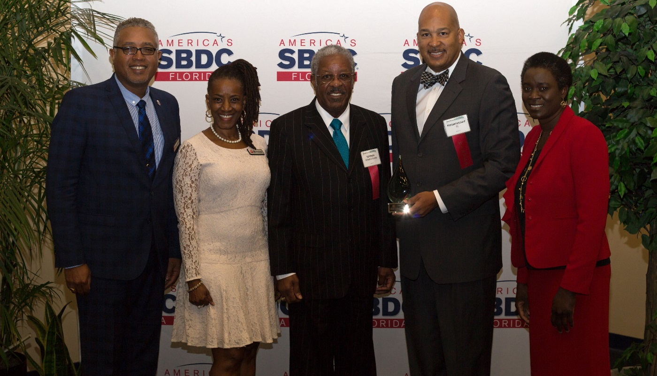
Back-2-Work Program Success
Over the last 36 months:
Sponsored and/or participated in 58 development seminars
485 small businesses attended development seminars
125 persons hired either PT/FT positions with local agencies via B2W training program
2018 – Nominated for and received the coveted SBA North District Community Partner of the Year Award

